Slide 1

Theory of Automata & Formal Languages CS-224
Sir Syed University of Engineering & Technology, Karachi

Slide 2
Introduction To Transducers (DFA with Output)
In the previous Topics, an abstract model of a machine that accepts input values but doesn't produce any output values, was discussed.
In the case of FSA (finite state automata), movements from state xi to xj depend on the input at xi and no output emerges.
Some machines, however, produce output values after accepting input values.
In the case of FSM, a move from a state xi to state xj results in an output.

Slide 3
Introduction To Transducers (DFA with Output)
Tuples for Transducer:
1. Q is a finite set called the states
2. Σ is a finite set called the alphabet
3. Γ is a finite set called the output alphabet
4. δ : Q × Σ ∪ {ε} → Q, Γ is the transition function
Next State = {Current State, Input}
Output = {Current State}
5. q0 ∈ Q is the start state

Slide 4
Introduction To Transducers (DFA with Output)
Two classical machines are designed that transform input strings into output strings. They are:
Moore machine – M₀, named after Edward Moore, who introduced it in 1956.
Mealy machine – M_{e}, named after George H.Mealy, who introduced it in 1955.
These machines are basically DFAs, except that they associate an output symbol with each state or with each state transition.
However, there are no final states, because there is no acceptance or rejection involved.

Slide 5
Moore machine – M₀
Moore machine is a finite state machine with the output philosophy - One State - One output.
Every state will have an output associated with it. Even the start state.
You can have an output since the machine is in the start state and it has an output.
Moore machines can respond to empty string.
X0
a/b
X1 / 1
/ 0
X0 / 0
a
X1 / 1
b
X2 / 0

Slide 6
Example: Count the numbers of a’s in the given input.
How to draw a transducer for the given problem.
Check for the pattern that needs to be count.
Consider the given pattern as an ending pattern.
Draw the DFA with that restriction.
b
a
X0
a
X1
b

Slide 7
Example: Count the numbers of a’s in the given input.
How to draw a transducer for the given problem.
Check for the pattern that needs to be count.
Consider the given pattern as an ending pattern.
Draw the DFA with that restriction.
Put 1 as output in the final state.
Put 0 as output in the remaining states.
Make final state as non final state.
b
a
X0
a
X1
/0
/ 1
b
b
a
X0
a
X1
/0
/ 1
b

Slide 8
b
a
X0
a
X1
Input : abaaba
/0
/ 1
b
Input |  | a | b | a | a | b | a
State | x0
Output
x1
x0
x1
x1
x0
x1
0
1
0
1
1
0
1

Slide 9
Count the pattern ab in the given input
How to draw a transducer for the given problem.
Check for the pattern that needs to be count.
Consider the given pattern as an ending pattern.
Draw the DFA with that restriction.
Put 1 as output in the final state.
Put 0 as output in the remaining states.
Make final state as non final state.
b
a
a
X0
X1
X2
a
b
/ 1
/0
/0
b
b
a
a
X0
X1
X2
a
b
/ 1
/0
/0
b

Slide 10
Input : aabbaababab
b
a
a
X0
X1
X2
a
b
/ 1
/0
/0
b
Input |  | a | a | b | b | a | a | b | a | b | a | b
State | x0
Output
x1
x1
x2
x0
x1
x1
x2
x1
x2
x1
x2
0
0
0
1
0
0
0
1
0
1
0
1

Slide 11
Count the pattern aba in the given input
b
a
a
X0
X1
X2
a
X3
a
b
b
b
b
a
a
X0
X1
X2
a
X3
a
b
/0
/ 1
/0
/0
b
a
b
b
a
X0
X1
X2
a
X3
a
b
/0
/ 1
/0
/0
b
b

Slide 12
Count all the occurrence of aba and bb in the input (Single Moore Machine)
a
a
b
X0
X1
b
X2
a
X3
a
/ 1
/0
/0
/0
a
b
a
b
a
a
X4
X5
b
b
X0
X1
X2
X3
/0
/ 1
a
b
a
/0
/0
/0
/ 1
b
a
b
a
b
X4
b
X5
/0
/ 2
b

Slide 13
Mealy machine – M_{e}
Mealy machine is a machine in which output symbol depends upon the present input symbol.
In the Mealy machine, the output is represented with each input symbol for each state separated by /.
a/0,
b/0
X0
X1
X0
a/1
X1
b/0
X2

Slide 14
Example: Count the numbers of a’s in the given input.
How to draw a transducer for the given problem.
Check for the pattern that needs to be count.
Consider the given pattern as an ending pattern.
Draw the DFA with that restriction.
b
a
X0
a
X1
b

Slide 15
Example: Count the numbers of a’s in the given input.
How to draw a transducer for the given problem.
Check for the pattern that needs to be count.
Consider the given pattern as an ending pattern.
Draw the DFA with that restriction.
Put 1 as output with all those edges that end in final state.
Put 0 as output with all remaining edges.
Make final state as non final state.
b
a
/0
/ 1
X0
a
X1
/ 1
b
/0
b
a
/0
/ 1
X0
a
X1
/ 1
b
/0

Slide 16
Example: Count the occurrence of pattern bab in the given input.
How to draw a transducer for the given problem.
Check for the pattern that needs to be count.
Consider the given pattern as an ending pattern.
Draw the DFA with that restriction.
a
b
X0
b
X1
a
X2
a
b
a
b
X3

Slide 17
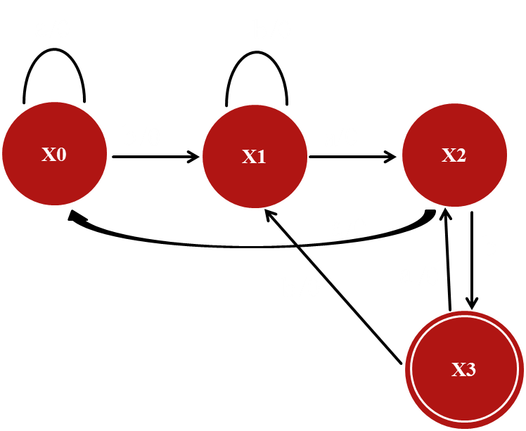
Example: Count the occurrence of pattern bab in the given input.
How to draw a transducer for the given problem.
Check for the pattern that needs to be count.
Consider the given pattern as an ending pattern.
Draw the DFA with that restriction.
Put 1 as output with all those edges that end in final state.
Put 0 as output with all remaining edges.
Make final state as non final state.
a
b
/0
/0
X0
b
X1
a
X2
/0
/0
a
/0
b
/1
a
b
/0
/0
X3
/1

Slide 18
Input: abaababab
/1
Input |  | a | b | a | a | b | a | b | a | b
State
Output
x0
x0
x1
x2
x0
x1
x2
x3
x2
x3
0
0
0
0
0
0
1
0
1

Slide 19
Conversion from Mo To Me
a
b
a
Remove the output from Start state, if there is no incoming edge.
Place the output of sate with the incoming edges to that state.
X0
X1
X2
a
X3
a
b
/0
/1
/0
/0
b
b
a
b
a
X0
X1
X2
a
X3
a
b
/0
/1
/0
/0
b
b

Slide 20
Conversion from Mo To Me
a
b
a
Remove the output from Start state, if there is no incoming edge.
Place the output of sate with the incoming edges to that state.
X0
X1
X2
a
X3
a
b
/0
/1
/0
/0
b
b
a
b
a
/0
X0
X1
X2
a
X3
a
b
/0
/1
/0
/0
b
b
/0

Slide 21
Conversion from Mo To Me
a
b
a
Remove the output from Start state, if there is no incoming edge.
Place the output of sate with the incoming edges to that state.
Remove the output from the state.
X0
X1
X2
a
X3
a
b
/0
/1
/0
/0
b
b
a
b
a
/0
X0
X1
X2
a
X3
a
b
/0
/1
/0
/0
b
b
/0

Slide 22
Conversion from Mo To Me
a
b
a
Remove the output from Start state, if there is no incoming edge.
Place the output of sate with the incoming edges to that state.
Remove the output from the state.
Perform step-2,3 for all states in DFA.
X0
X1
X2
a
X3
a
b
/0
/1
/0
/0
b
b
a
b
a
/0
X0
X1
X2
a
X3
a
b
/0
/1
/0
b
b
/0

Slide 23
Conversion from Mo To Me
a
b
a
Remove the output from Start state, if there is no incoming edge.
Place the output of sate with the incoming edges to that state.
Remove the output from the state.
Perform step-2,3 for all states in DFA.
X0
X1
X2
a
X3
a
b
/0
/1
/0
/0
b
b
a
b
a
/0
/0
/0
X0
X1
X2
a
X3
a
b
/0
/0
/1
/0
b
b
/0

Slide 24
Conversion from Mo To Me
a
b
a
Remove the output from Start state, if there is no incoming edge.
Place the output of sate with the incoming edges to that state.
Remove the output from the state.
Perform step-2,3 for all states in DFA.
X0
X1
X2
a
X3
a
b
/0
/1
/0
/0
b
b
a
b
a
/0
/0
/0
X0
X1
X2
a
X3
a
b
/0
/0
/1
b
b
/0

Slide 25
Conversion from Mo To Me
a
b
a
Remove the output from Start state, if there is no incoming edge.
Place the output of sate with the incoming edges to that state.
Remove the output from the state.
Perform step-2,3 for all states in DFA.
X0
X1
X2
a
X3
a
b
/0
/1
/0
/0
b
b
a
b
a
/0
/0
/0
X0
X1
X2
a
X3
a
b
/0
/0
/0
/1
b
/0
b
/0

Slide 26
Conversion from Mo To Me
a
b
a
Remove the output from Start state, if there is no incoming edge.
Place the output of sate with the incoming edges to that state.
Remove the output from the state.
Perform step-2,3 for all states in DFA.
X0
X1
X2
a
X3
a
b
/0
/1
/0
/0
b
b
a
b
a
/0
/0
/0
X0
X1
X2
a
X3
a
b
/0
/0
/1
b
/0
b
/0

Slide 27
Conversion from Mo To Me
a
b
a
Remove the output from Start state, if there is no incoming edge.
Place the output of sate with the incoming edges to that state.
Remove the output from the state.
Perform step-2,3 for all states in DFA.
X0
X1
X2
a
X3
a
b
/0
/1
/0
/0
b
b
a
b
a
/0
/0
/0
X0
X1
X2
a
X3
a
b
/1
/0
/0
/1
b
/0
b
/0

Slide 28
Conversion from Mo To Me
a
b
a
Remove the output from Start state, if there is no incoming edge.
Place the output of sate with the incoming edges to that state.
Remove the output from the state.
Perform step-2,3 for all states in DFA.
X0
X1
X2
a
X3
a
b
/0
/1
/0
/0
b
b
a
b
a
/0
/0
/0
X0
X1
X2
a
X3
a
b
/1
/0
/0
b
/0
b
/0

Slide 29
Conversion from Me To Mo Example:-1
X0
a
X1
Place the output 0 with start state, if there is no incoming edge.
/0
b
/0
X2
X0
a
X1
/0
/0
b
/0
X2

Slide 30
Conversion from Me To Mo Example:-1
X0
a
X1
Place the output 0 with start state, if there is no incoming edge.
Place the output of incoming edges with the state.
/0
b
/0
X2
X0
a
X1
/0
/0
b
/0
X2

Slide 31
Conversion from Me To Mo Example:-1
X0
a
X1
Place the output 0 with start state, if there is no incoming edge.
Place the output of incoming edges with the state.
/0
b
/0
X2
X0
a
X1
/0
/0
/0
b
/0
X2
/0

Slide 32
Conversion from Me To Mo Example:-1
X0
a
X1
Place the output 0 with start state, if there is no incoming edge.
Place the output of incoming edges with the state.
Remove the output of edges.
/0
b
/0
X2
X0
a
X1
/0
/0
/0
b
/0
X2
/0

Slide 33
Conversion from Me To Mo Example:-1
X0
a
X1
Place the output 0 with start state, if there is no incoming edge.
Place the output of incoming edges with the state.
Remove the output of edges.
/0
b
/0
X2
X0
a
X1
/0
/0
b
X2
/0

Slide 34
Conversion from Me To Mo Example: 2
a
b
a
/0
/0
/0
X0
X1
X2
a
X3
a
b
/1
/0
/0
b
/0
b
/0

Slide 35
Conversion from Me To Mo Example: 2
a
b
a
/0
/0
/0
X0
X1
X2
a
X3
a
b
/1
/0
/0
/0
b
/0
b
/0

Slide 36
Conversion from Me To Mo Example: 2
a
b
a
/0
/0
X0
X1
X2
a
X3
a
b
/1
/0
/0
/0
b
/0
b

Slide 37
Conversion from Me To Mo Example: 2
a
b
a
/0
/0
X0
X1
X2
a
X3
a
b
/1
/0
/0
/0
/0
b
/0
b

Slide 38
Conversion from Me To Mo Example: 2
a
b
a
X0
X1
X2
a
X3
a
b
/1
/0
/0
/0
b
/0
b

Slide 39
Conversion from Me To Mo Example: 2
a
b
a
X0
X1
X2
a
X3
a
b
/1
/0
/0
/0
/0
b
/0
b

Slide 40
Conversion from Me To Mo Example: 2
a
b
a
X0
X1
X2
a
X3
a
b
/0
/1
/0
/0
b
b

Slide 41
Conversion from Me To Mo Example: 2
a
b
a
X0
X1
X2
a
X3
a
b
/0
/1
/1
/0
/0
b
b

Slide 42
Conversion from Me To Mo Example: 2
a
b
a
X0
X1
X2
a
X3
a
b
/0
/1
/0
/0
b
b

